Slide 1
How social media is affecting our lives?
Presented by: Hamza Shahid(20P-0117)

Slide 2

What is Social
Media?
Connecting people from all over the world through some means

Slide 3
When and how did it got the Trending?
Started with Friendster (2002) and MySpace (2003)
Launch of Facebook (2004)
Opened its doors to the general public in 2006.

Slide 4
ADVANTAGES
Connectivity and Communication
Information and News Sharing
Professional Opportunities
Creative Expression
Business Promotion and Marketing

Slide 5
DISADVANTAGES
Privacy Concerns
Cyberbullying and Harassment
Addiction and Time Consumption
Spread of Misinformation
Social Comparison and Self-Esteem Issues

Slide 6
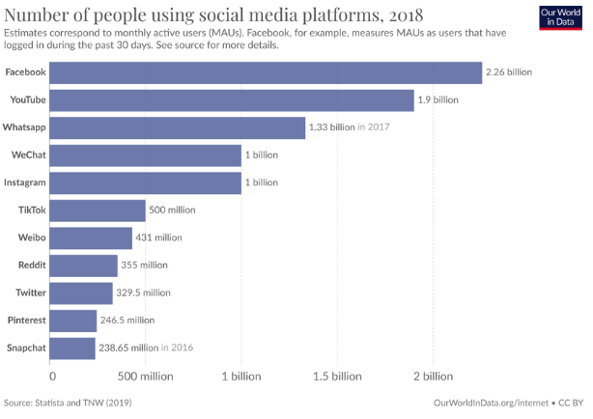
Usage of social media

Slide 7
Thanks :)

